Slide 1
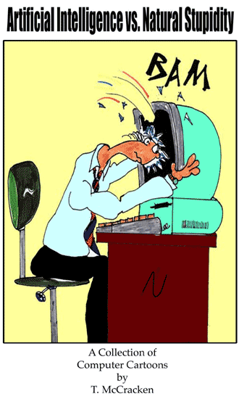
CS 4200: Artificial Intelligence
Dr. Daisy Tang

Slide 2
Outline
Course Overview
What is Artificial Intelligence (AI)
History of AI
The State of the Art

Slide 3
Course Overview
See blackboard

Slide 4
Course Overview
Week/Module 1:
Introduction; Intelligent agents
Week/Module 2:
Uninformed Search; Informed Search
Week/Module 3:
Local search; Constraint Satisfaction Problem
Week/Module 4:
Adversarial Search; Logical Agent
Week/Module 5:
First-Order Logic; Planning

Slide 5
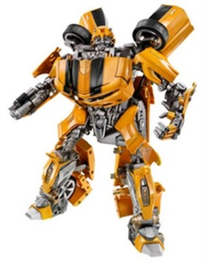
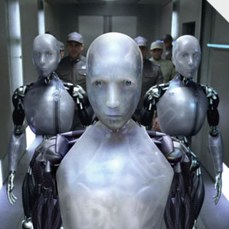

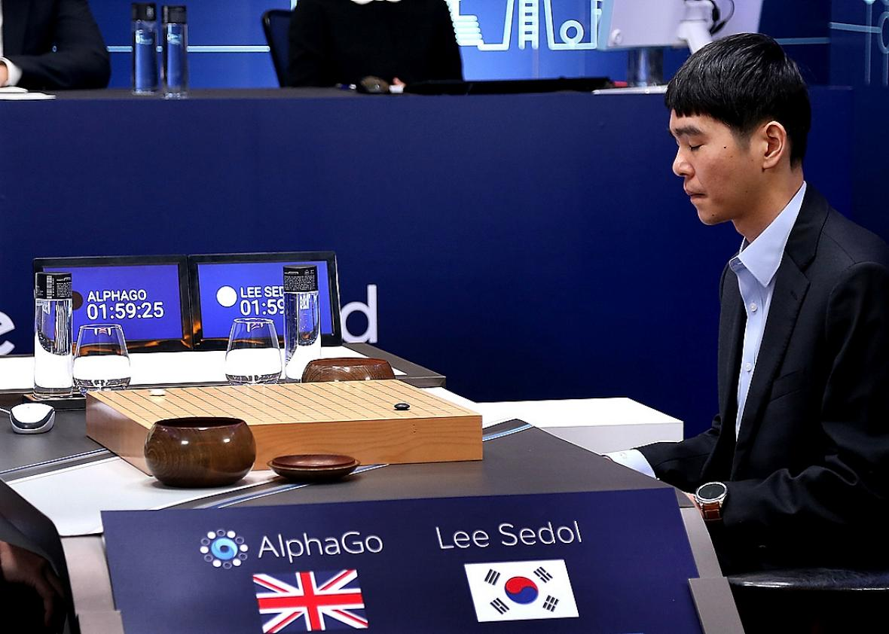

What is AI?

Slide 6
Definition from John McCarthy
It is the science and engineering of making intelligent machines, especially intelligent computer programs.
What is intelligence then?
The computational part of the ability to achieve goals in the world. Varying kinds and degrees of intelligence occur in people, many animals and some machines.
John McCarthy’s What is AI?
http://www-formal.stanford.edu/jmc/whatisai/whatisai.html

Slide 7
The Rise of AI
Do you use AI in your daily life?
Some examples:
Google Assistant can now make real phone calls for you:
https://www.youtube.com/watch?v=JvbHu_bVa_g
Covid-19 accurately diagnosed by AI model
https://www.genengnews.com/news/covid-19-accurately-diagnosed-by-ai-model/

Slide 8
In-Class Exercise #1.1
Requirements:
Please write a 1-2 paragraphs of summary about your own definition of AI (in your own words) followed by the discussion of one recent event on how AI is being used in our daily life.
Please include a link to either a youtube video or an article that your reference.
Submission Deadline: 7/4/2020

Slide 9
Four Categories Views of AI
Please watch a short video about 4 views of AI
Thinking Humanly
Acting Humanly
Thinking Rationally
Acting Rationally

Slide 10
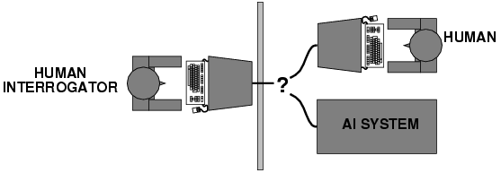
Acting Humanly: Turing Test
Proposed by Alan Turing in 1950
Suggested major components of AI? Loebner Prize (Mitsuku, 2016 winner)
http://www.loebner.net/Prizef/loebner-prize.html

Slide 11
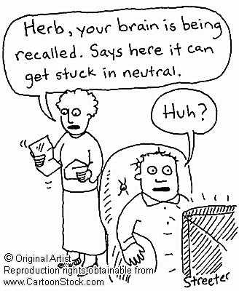
Thinking Humanly: Cognitive Modeling
Requires scientific theories of internal activities of the brain
How to validate? Requires
Predicting and testing behavior of human subjects
Direct identification from neurological data
Both approaches (roughly, Cognitive Science and Cognitive Neuroscience) are now distinct from AI

Slide 12
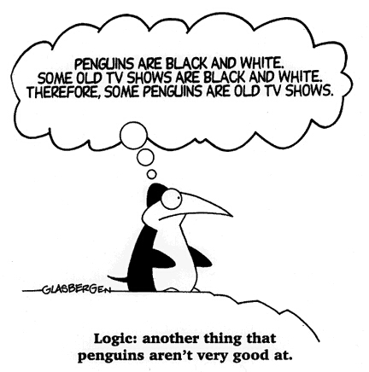
Thinking Rationally: Laws of Thoughts
Aristotle:
what are correct arguments/thought processes?
Problems:
not easy to state informal knowledge in the formal terms required by logical notation
big difference between being able to solve a problem in principle and doing so in practice

Slide 13
Acting Rationally: Rational Agent
Agent: something that acts
Agents are not merely “program”
Rational: doing the right thing
It is expected to maximize goal achievement, given the available information
Doesn't necessarily involve thinking – e.g., blinking reflex – but thinking should be in the service of rational action
Two advantages: more general than “thinking rationally”, better than human standards

Slide 14
Foundations of AI
Philosophy Logic, methods of reasoning, mind as physical system foundations of learning, language, rationality
Mathematics Formal representation and proof algorithms, computation, (un)decidability, (in)tractability, probability
Economics utility, decision theory, game theory
Neuroscience physical substrate for mental activity
Psychology phenomena of perception and motor control, experimental techniques
Computer building fast computers engineering
Control theory design systems that maximize an objective function over time
Linguistics knowledge representation, natural language

Slide 15
History of AI
1943 McCulloch & Pitts: Boolean circuit model of brain
1950 Turing's "Computing Machinery and Intelligence"
1956 Dartmouth meeting: "Artificial Intelligence" adopted
1952—69 Look, Ma, no hands!
1950s Early AI programs, including Samuel's checkers program, Newell & Simon's Logic Theorist, Gelernter's Geometry Engine
1965 Robinson's complete algorithm for logical reasoning
1966—73 AI discovers computational complexity Neural network research almost disappears
1969—79 Early development of knowledge-based systems
1980-- AI becomes an industry
1986-- Neural networks return to popularity
1987-- AI becomes a science
1995-- The emergence of intelligent agents
2011-- Availability of very large data sets

Slide 16
Branches of AI
Logical AI
Search
Pattern recognition
Representation
Inference
Common sense knowledge and reasoning
Learning from experience
Planning
Heuristics
Genetic programming
Robotics
And many others

Slide 17
State of the Art
Machine learning
Robotics: DARPA Grand/Urban Challenges
Speech recognition: banking agent, travel agent
Autonomous planning and scheduling: NASA’s autonomous planning programs
Game playing: IBM’s Deep Blue, Google’s AlphaGo
Spam fighting
Logistic planning: during the Persian Gulf crisis of 1991, U.S. forces deployed a tool to do automated logistics planning and scheduling for transportation, hours vs. weeks of efforts
Robotics: Roomba that helps cleanning, PackBots that handle hazardous materials, clear explosives and identify location of snipers
Machine translation
…… many others

Slide 18
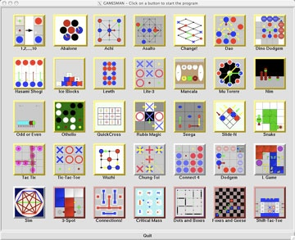
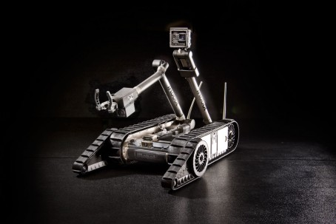
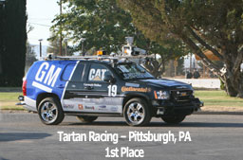
Examples
Packbot 510
gamescrafter @ Berkeley
Autonomous Vehicle
DARPA Urban Challenge
https://www.youtube.com/watch?v=cdgQpa1pUUE (Self Driving Car)
https://www.youtube.com/watch?v=vC66XFoN4DE (Alpha Go)

Slide 19
In-Class Exercise #1.2
Requirements:
Given the most recent AI application (you can reuse the same application from the previous exercise or a brand new one), list the key areas of AI that you will need to explore to implement this application.
Submission Deadline: 7/11/2021

Slide 20
Next Subject …
Intelligent agent

